Slide 1
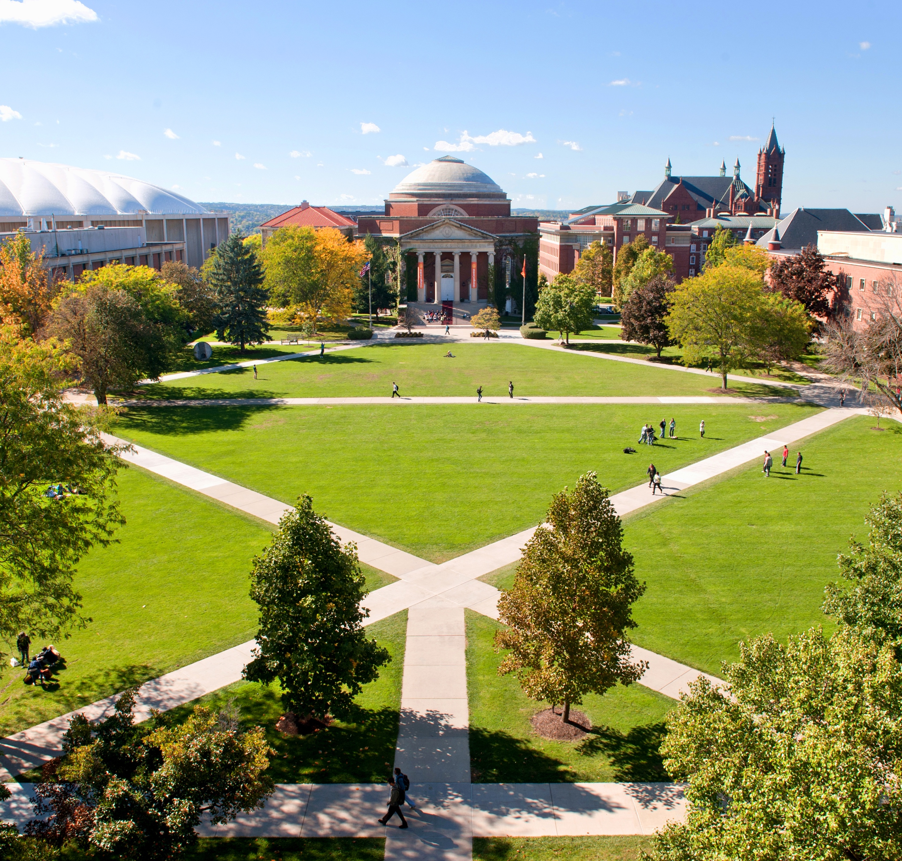
Fundraising interaction summaries
Gary Chen Charles Cheung Matt Maloney

Slide 2
Syracuse University Fundraising Data
Key terms
Fundraiser
Prospect / constituent
Interaction
Contact report
Discovery
Cultivation
Solicitation
Negotiation
Best rating
Campaign commitment

Slide 3
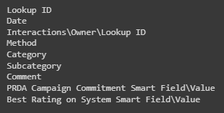
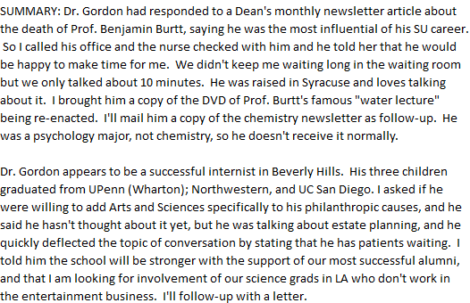
Syracuse University Fundraising Data
Describing the data
Face to face interactions, 2013 -
32,950 interactions
~11,700 constituents
~260 fundraisers
Commitments ranging between $0 and $87 million

Slide 4
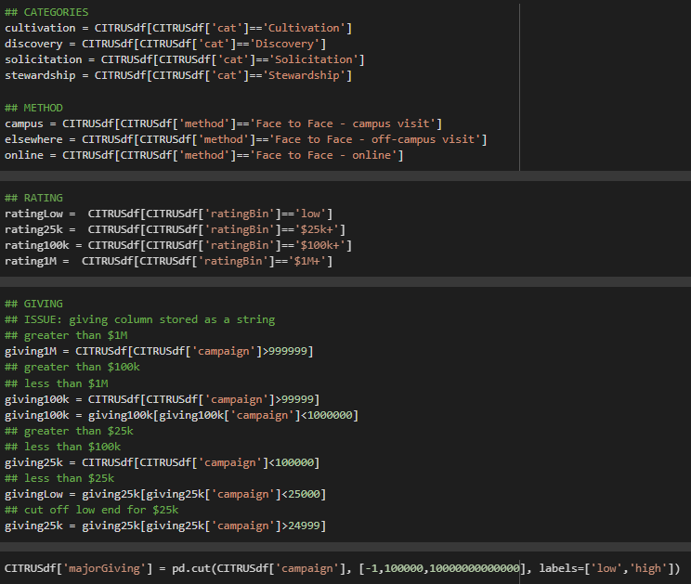
Pre-processing
Structural
Data frame
Bucketing / categorization

Slide 5
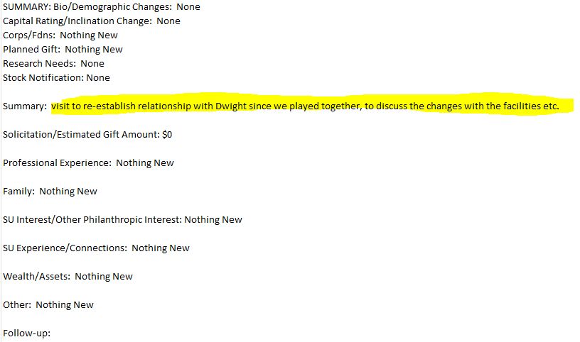
Pre-processing
NLP
Tokenization
Stop words
Additional stop words
Lemmatization

Slide 6
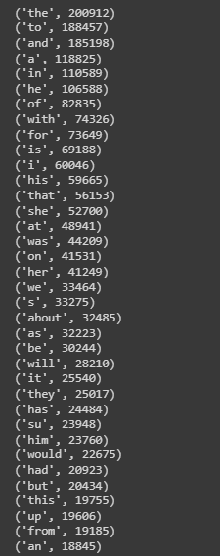
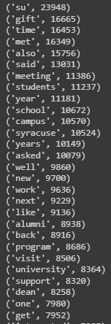
NLP investigation
Frequency distribution
Before and after stop words

Slide 7
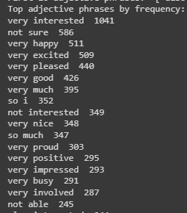
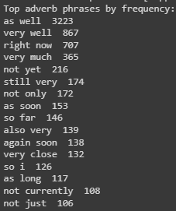
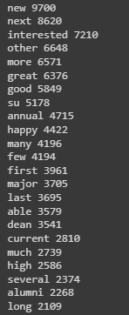
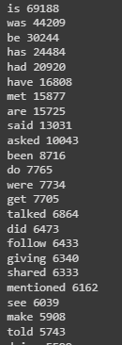
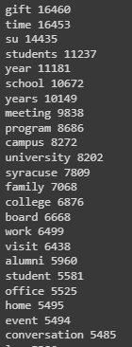

NLP investigation
POS tagging

Slide 8
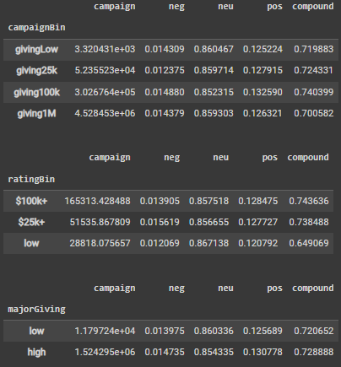
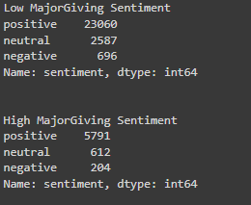

NLP investigation
Polarity
Most comments are classified as 'positive' sentiment
The higher the rating bin, the higher the avg positive polarity score
In our High Major donation group, we also saw a higher avg positivity score
Notes:
One hypothesis for the positivity increasing in correlation with the ratingBin is that gift officers might have a “positivity halo” as they recall their encounters with high-net-worth prospects.

Slide 9
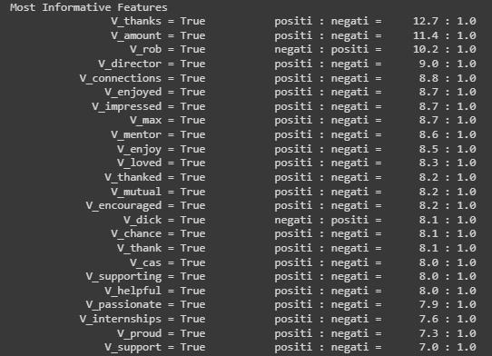
NLP investigation
Naïve Bayes
Cross-validation
Accuracy
Precision
Recall
F-measure

Slide 10


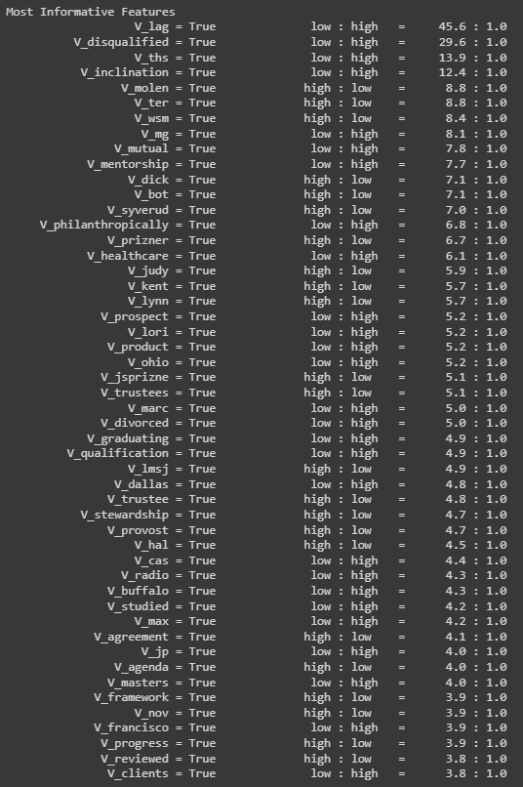
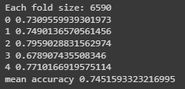
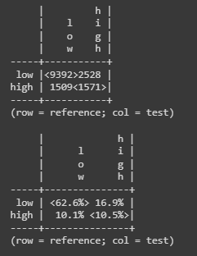
NLP investigation
Naïve Bayes
Cross-validation
Accuracy
Precision
Recall
F-measure

Slide 11
References
Links:
2su IST-664 Labs 1-9
https://sparkbyexamples.com/pandas/conver-pandas-column-to-list/
https://stackoverflow.com/questions/13682044/remove-unwanted-parts-from-strings-in-a-column
https://data-science-blog.com/en/blog/2018/11/04/sentiment-analysis-using-python/
https://www.geeksforgeeks.org/how-to-search-and-replace-text-in-a-file-in-python/
https://www.red-gate.com/simple-talk/development/data-science-development/sentiment-analysis-python/
https://www.kirenz.com/post/2021-12-11-text-mining-and-sentiment-analysis-with-nltk-and-pandas-in-python/text-mining-and-sentiment-analysis-with-nltk-and-pandas-in-python/

Slide 12
Questions

